Slide 1
High Current Testing of Molded Case Circuit Breakers
Jim Doran x4515

Slide 2
Objectives
Upon completion of this class, you will be able to:
State the safety precautions which are required when testing molded case circuit breakers.
State the faults that are protected against with both thermal and magnetic circuit breaker trips.
Explain why a circuit breakers are ambient compensated.
Explain the differences between a thermal and magnetic circuit breaker trips.

Slide 3
Objectives (continued)
Determine a molded case breaker’s rating.
Determine the instantaneous trip point of a molded case circuit breaker in accordance with C MP 782AE.
Determine the thermal overload test current of a molded case circuit breaker in accordance with C MP 782AE.
Describe and demonstrate connecting the Multi-amp CB 8130 to a molded case circuit breaker for circuit breaker high current testing in accordance with C MP 782AE.
Describe and demonstrate the setup of the Multi-amp CB 8130 in accordance with C MP 782AE for both thermal and instantaneous circuit breaker high current testing.

Slide 4
Objectives (continued)
Explain the purpose of the 5 minute wait between phases during thermal trip testing.
Identify the three states of a molded case circuit breaker.
Demonstrate the ability to perform high current testing of molded case circuit breakers.

Slide 5
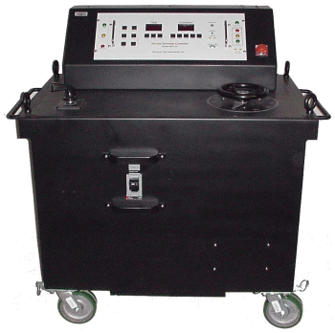
Breaker Testing
= $$$$$

Slide 6
Class Preview
13:00 – 13:50 – Lecture
14:00 – 14:50 – Lab
15:00 – 16:00 – Review and Test

Slide 7
Circuit Breakers
Thermal Trip
Magnetic Trip
Thermal Magnetic Circuit Breaker

Slide 8
Breaker Faults

Slide 9
Breaker Faults
Phase to Phase Short Circuit

Slide 10
Breaker Faults
P = V * I
Undervoltage Condition

Slide 11
Breaker Faults
Motor Ground

Slide 12
Breaker Faults
Motor Overload

Slide 13
Thermal Trips
Reference (Csanya, March 2011): [Circuit Breaker Illustration]. Retrieved April 25, 2014 from http://electrical-engineering-portal.com

Slide 14
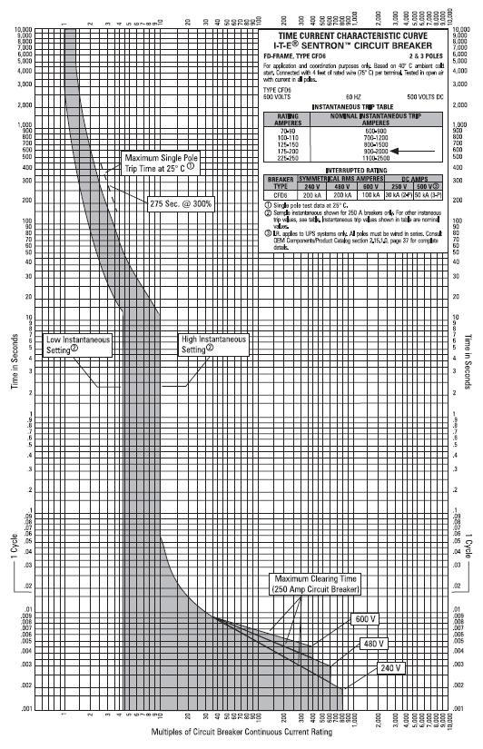
Breaker Curve
From C MP 782AE
Time in Seconds
Logarithmic Scale
Multiple of Rated Current

Slide 15
Instantaneous Trips
Magnetic Field
Breaker Closed
Breaker Tripped
Reference (Csanya, March 2011): [Circuit Breaker Illustration]. Retrieved April 25, 2014 from http://electrical-engineering-portal.com

Slide 16
Breaker Testing
Allowable Trip Range
Too Low
Too High
SAT
UNSAT
UNSAT
Breaker Stays Closed
Breaker Trips
Minimum of Two Tests

Slide 17
Any Questions
Jim Doran x4515

